Slide 1
ICE DEPOSITION RATE ON THE MOON
Dr. Beau Webber (J. Beau W. Webber) 2021-10-02
Dr.BeauWebber@gmail.com
The aim of this project is to measure ICE DEPOSITION RATE in the shade ON THE MOON, using time-domain NMR.
The intention is to use a palm-top sized time-domain NMR spectrometer to measure nano-gram quantities of ice depositing on an exposed planar probe, in the shade on the moon.
This can help provide information on accessible water on the moon.

Slide 2
ICE DEPOSITION RATE ON THE MOON
This highly interesting paper is what has prompted me to create this project :
Implications of surface roughness in models of water desorption on the Moon
Björn J R Davidsson, Sona Hosseini
Monthly Notices of the Royal Astronomical Society, Volume 506, Issue 3, September 2021, Pages 3421–3429, https://doi.org/10.1093/mnras/stab1360

Slide 3
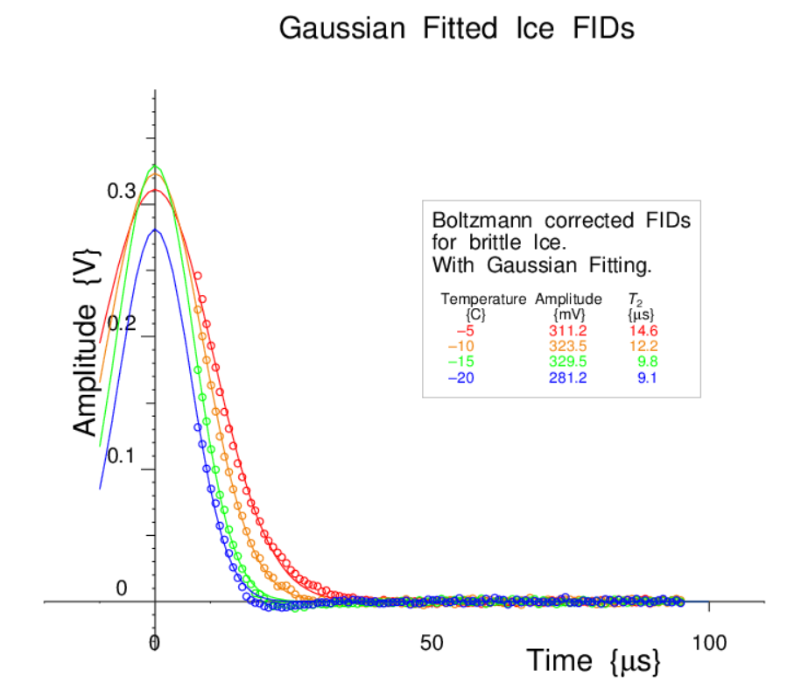
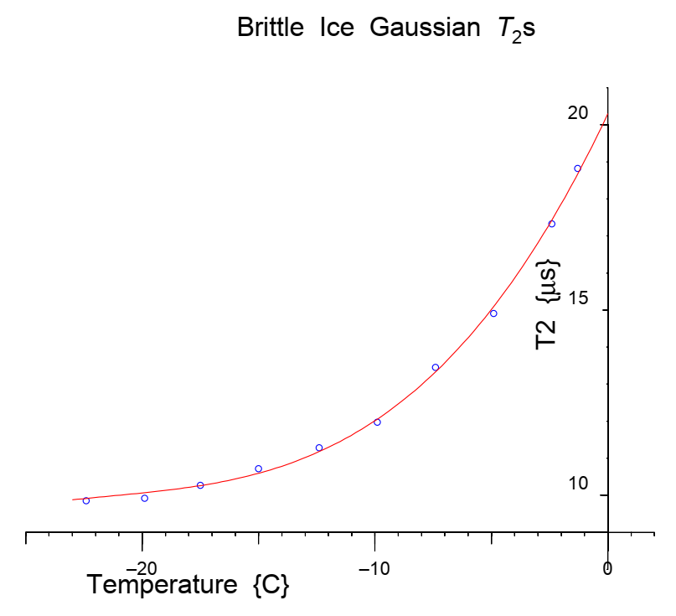
ICE DEPOSITION RATE ON THE MOON
A suitable time-domain NMR Spectrometer can measure the quantity of brittle ice in/on the NMR Probe. It can also determine the molecular mobility of the ice, which depends on both the temperature and the environment of the ice.
Here we measure the Free-Induction Decay for brittle ice at different temperatures, and then calculate the T2 decay time, which gives information on the rate of movement of the molecules.
These can be measured to much lower temperatures than are shown in these graphs.

Slide 4
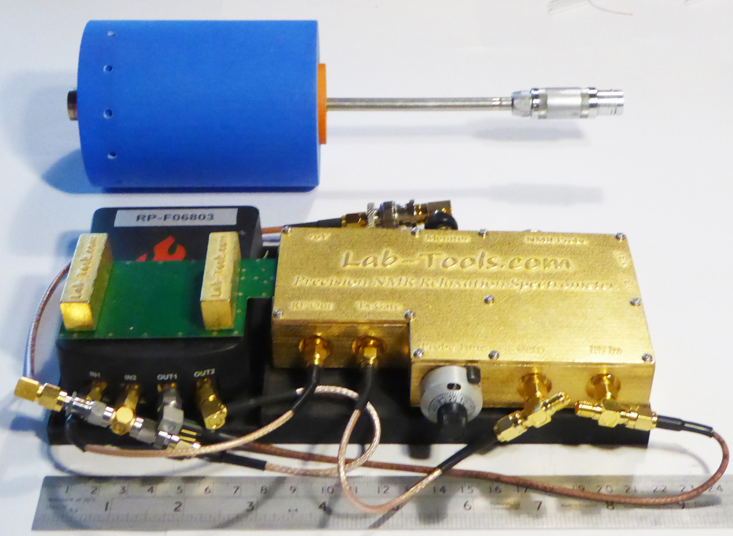
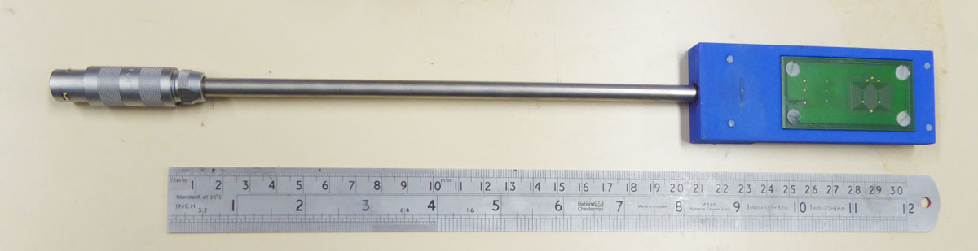
ICE DEPOSITION RATE ON THE MOON
A suitable palm-sized NMR Spectrometer that we have designed and constructed is shown (1 kG).
An example compact permanent magnet is also shown (< 1kG) although an open geometry NMR Probe is more suitable for this application.
The NMR Spectrometer would probably need to be protected from moon temperatures - the thin-walled stainless steel downlead will assist with this.

Slide 5
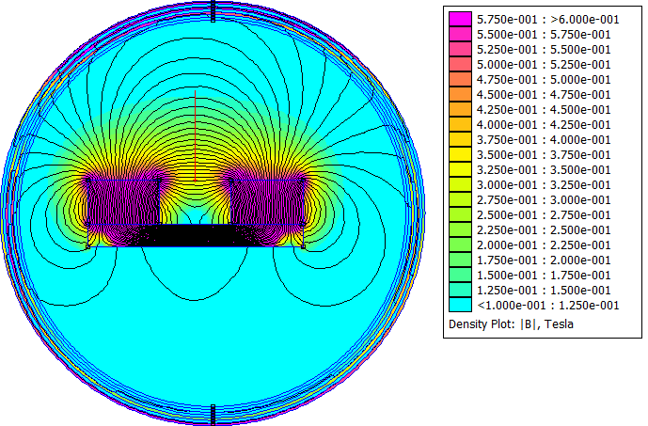
ICE DEPOSITION RATE ON THE MOON
Here we see a simulation of an example open NMR Magnet, suitable for a planar probe, created from 2 magnets on an iron plate.
It still has to be determined if the magnets need to be protected from moon temperatures.

Slide 6
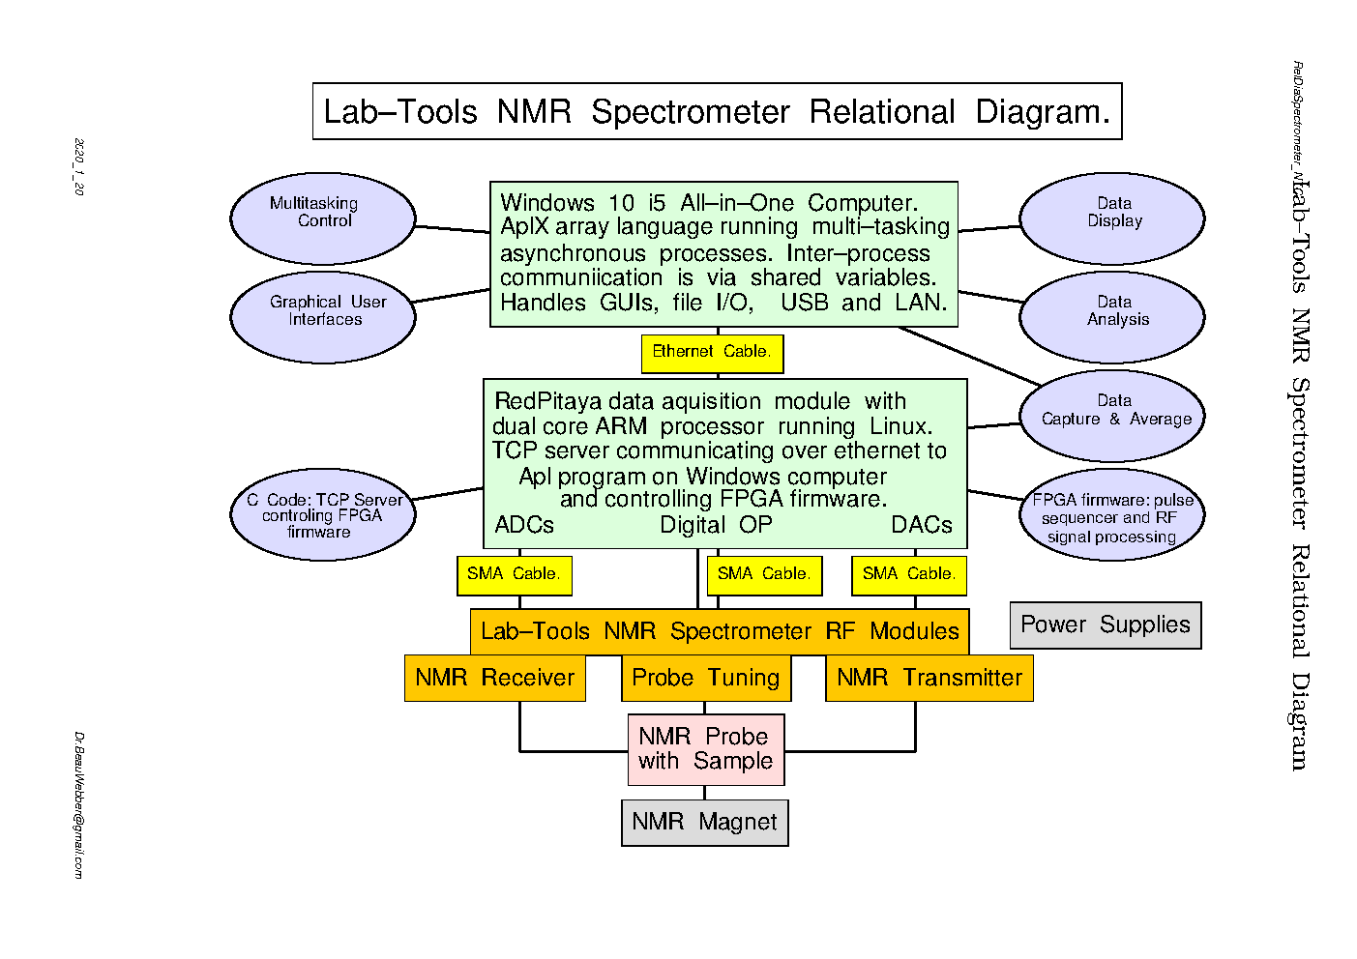
ICE DEPOSITION RATE ON THE MOON

Slide 7
ICE DEPOSITION RATE ON THE MOON
I have been designing, building and using compact time-domain NMR spectrometers since 1972.
I study the properties of ice, water and other liquids in pores and at interfaces using time-domain NMR and neutron scattering.
I then apply this to nano-metrology using NMR and neutron scattering including SANS.
REFERENCES
I have published over 50 papers discussing this work :
Dr. J. Beau W. Webber.
https://www.linkedin.com/in/beau-webber-43a43426/
www.Lab-Tools.com
+44 (0) 7805 437 241
ORCID : 0000-0002-8967-4671
https://scholar.google.com/citations?hl=en&user=2Vxx03MAAAAJ
http://www.lab-tools.com/publications/Webber_JBW.htm
My most recent paper is very relevant to this project :
A review of the use of simple time-domain NMR/MRI for material-science.
Webber, J.B.W.
SN Appl. Sci. 3, 809 (2021). DOI: 10.1007/s42452-021-04791-2
https://doi.org/10.1007/s42452-021-04791-2

